Slide 1
Individual Presentation
(Track 2)
Assignment Topic: Neural Network Models for Object Recognition

Slide 2
Contents
Introduction
EDA
Pre-Processing
Data partitioning
Architecture
Training
Evaluation
Code
Conclusion
References

Slide 3
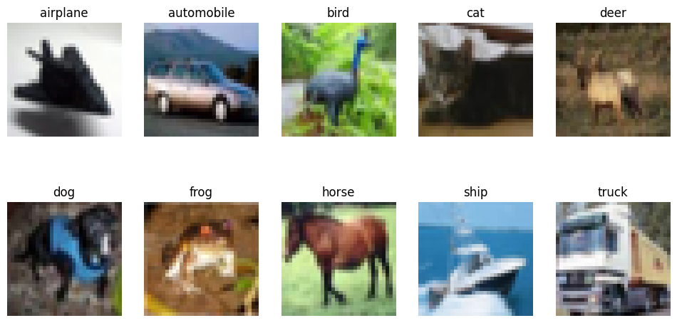
Introduction
Developed object recognition model using CIFAR-10 (Krizhevsky, 2009).
Used Deep Learning (CNNs + Transfer Learning) (Chollet, 2017).
Evaluated model performance on classification task.

Slide 4
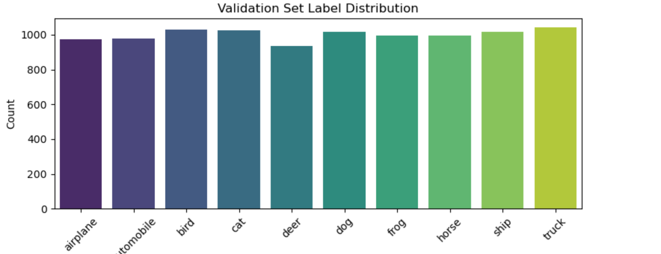
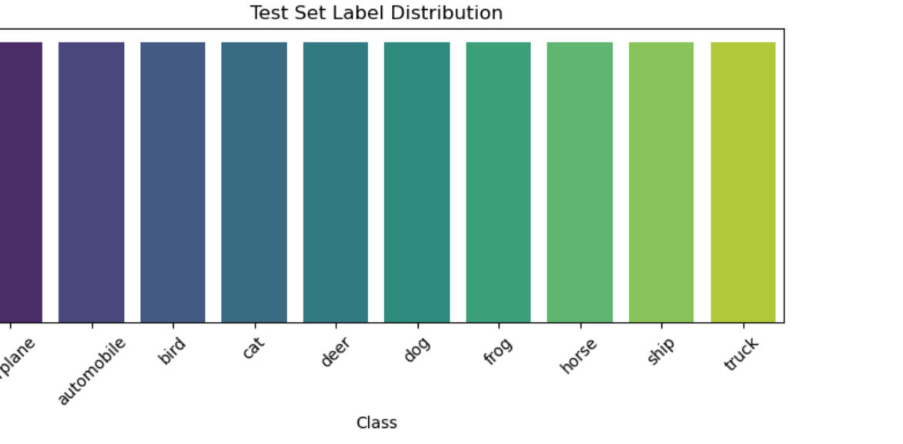
EDA
CIFAR-10: 60,000 images (32×32 RGB).
10 balanced classes (Krizhevsky, 2009): airplane, automobile, bird, cat, deer, etc.
Images are low-resolution and contain diverse features.
These bar plots illustrate the number of samples for each class in the training, validation, and test sets. All classes are equally distributed (6,000 total images per class), ensuring the model is not biased toward any category. This class balance helps improve the fairness and accuracy of evaluation metrics.

Slide 5
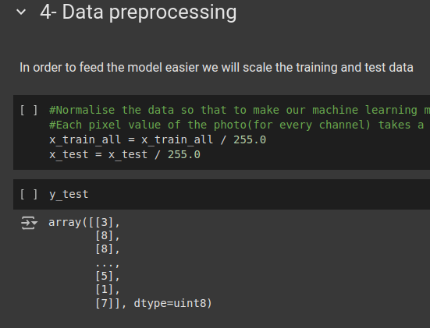
Preprocessing
Normalized pixel values: [0–255] → [0–1] (Brownlee, 2022).
Labels encoded using sparse_categorical
Resized images to 96×96 for MobileNetV2 (Howard et al., 2017).
Partitioned data: 40,000 train / 10,000 val / 10,000 test

Slide 6
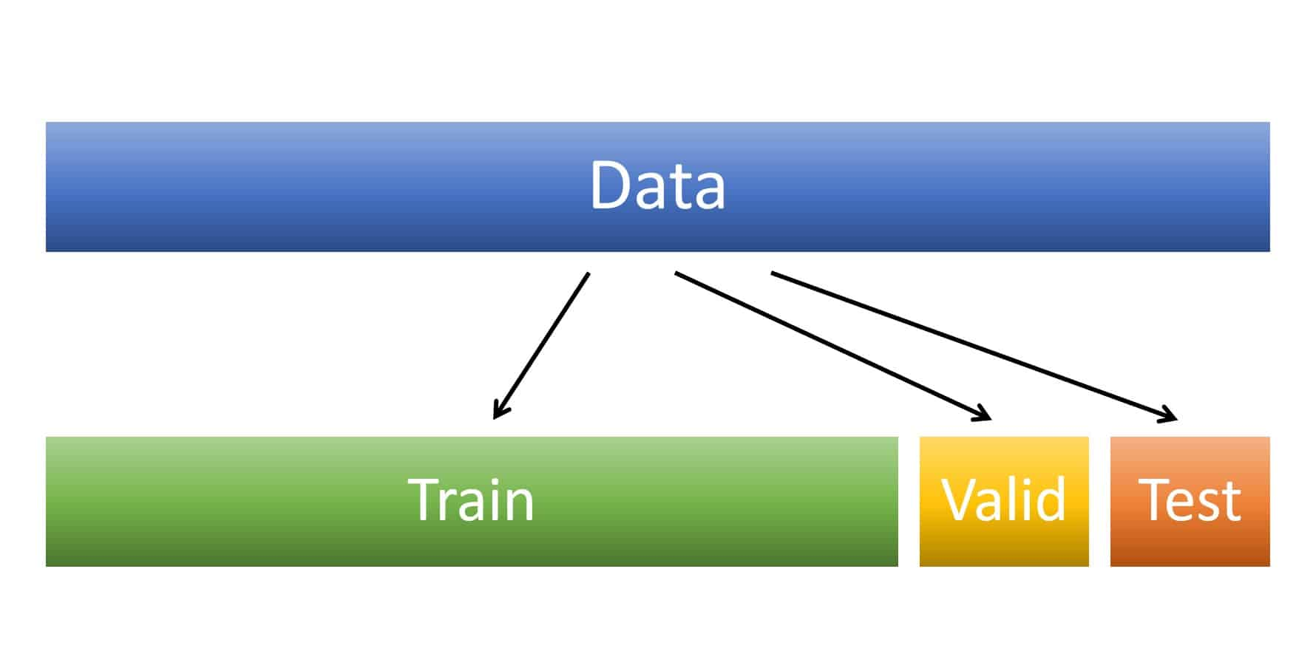

Data partitions
Training set: 40,000 images
Validation set: 10,000 images
Test set: 10,000 images
Split helps tune hyperparameters and avoid overfitting.

Slide 7
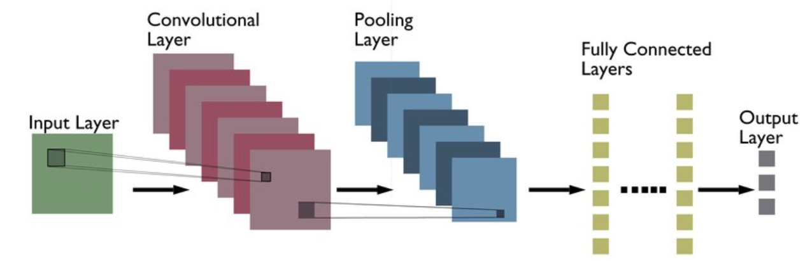
Architecture
2 Conv2D Layers + MaxPooling
Flatten + Dense(128) + Dropout(0.5) (Brownlee, 2022).
Output: Dense(10), softmax activation (Chollet, 2017).
Built using keras.Sequential

Slide 8
Architecture (Transfer Learning)
Base: MobileNetV2 (pretrained on ImageNet)
Top layers added: GAP → Dense(128) → Dropout → Dense(10)
Frozen base model initially (Howard et al., 2017; Deng et al., 2009).
Fine-tuned last 50 layers

Slide 9
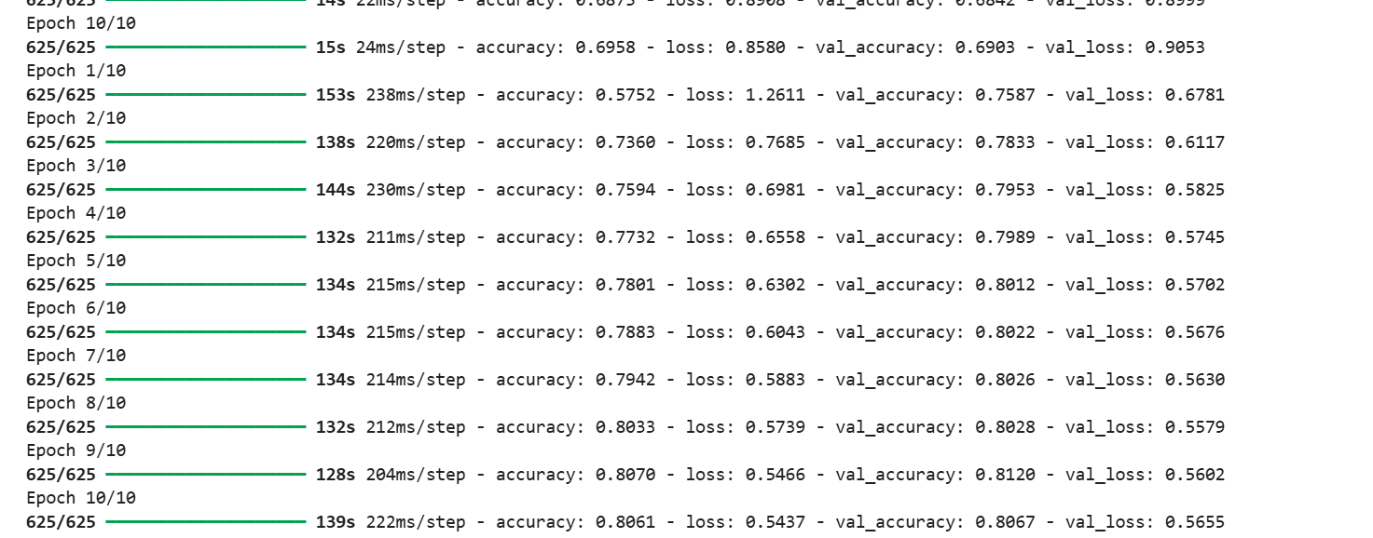
Training
Optimizer: Adam
Loss: sparse_categorical_crossentropy
Epochs: 20 (CNN), 10 + 10 (Transfer model)
Batch size: 64 (TensorFlow/Keras Docs, 2023).
Early stopping based on validation loss

Slide 10
Evaluation
CNN Test Accuracy: ~72%
MobileNetV2 Accuracy: ~85%
Confusion Matrix: Shows improved class separation
Classification Report: High precision/recall for most classes

Slide 11
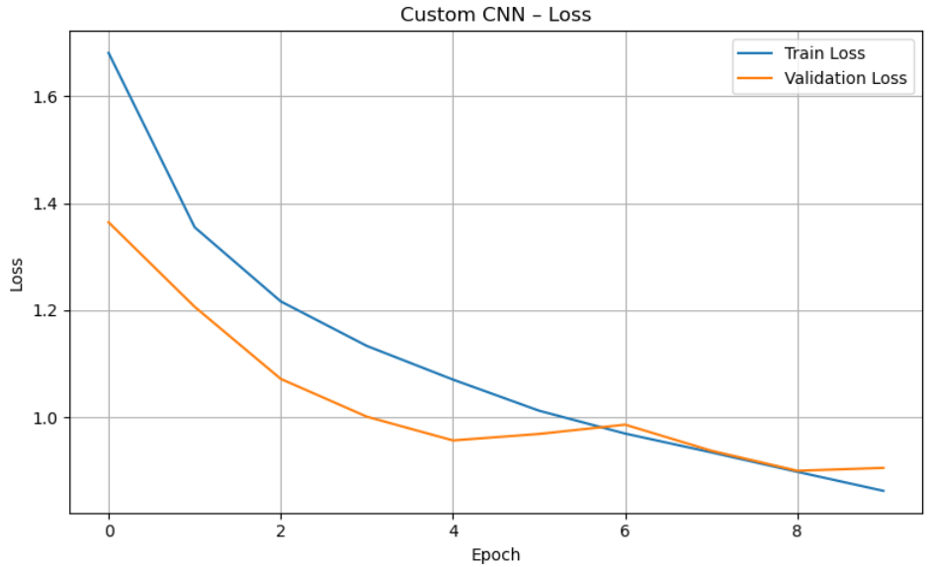
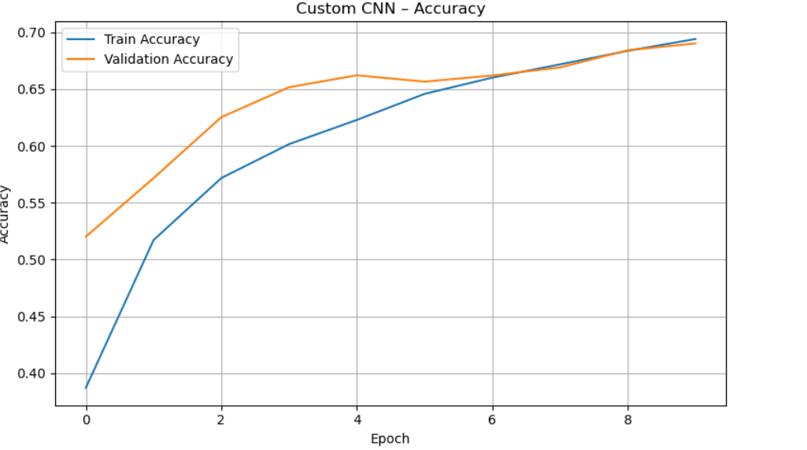
The training accuracy steadily improves across all epochs, showing the CNN is fitting to the training data. Validation accuracy also increases but at a slower rate. The gap between training and validation accuracy remains small, meaning the model generalises well and isn't heavily overfitting.
This line plot shows the training and validation loss over 10 epochs for the custom CNN. Initially, both losses decrease steadily, indicating that the model is learning. Around epoch 6–7, the validation loss plateaus slightly, which may signal early signs of overfitting. However, the trend suggests the model is still generalizing reasonably well.

Slide 12
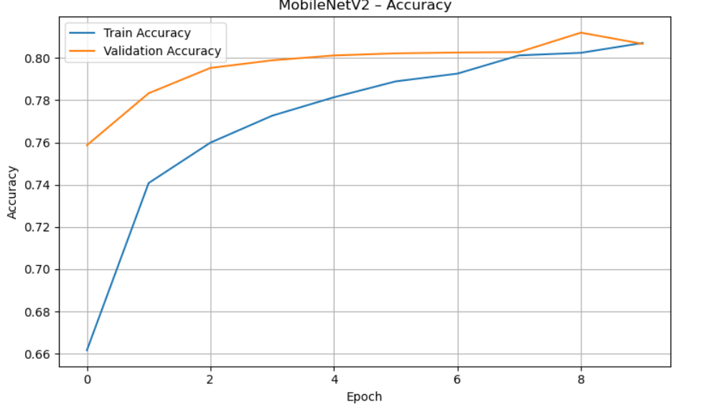
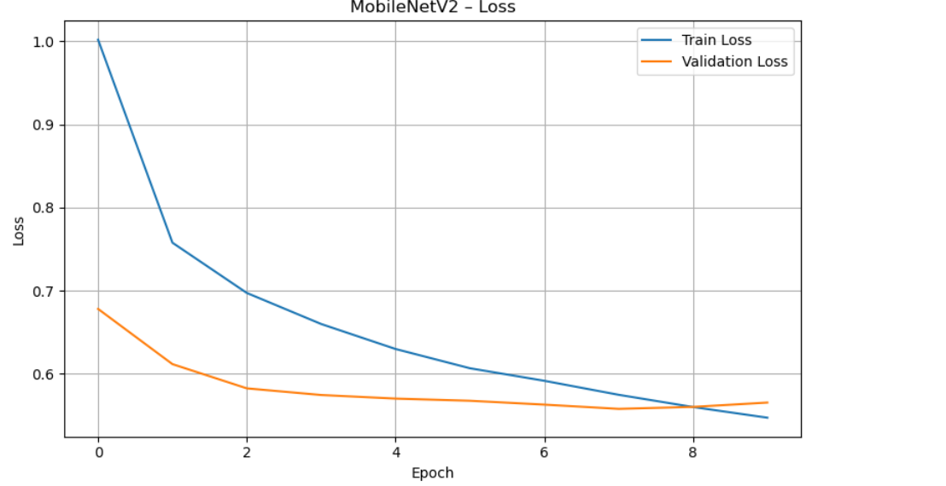
This plot shows a sharper and faster decrease in both training and validation loss, especially in early epochs. Since MobileNetV2 uses pretrained weights, it converges more quickly. The consistently low validation loss across epochs indicates strong generalization and minimal overfitting.
The pretrained MobileNetV2 model achieves high accuracy quickly, with both training and validation accuracy surpassing 80% within a few epochs. The narrow gap between the curves shows good model calibration and confirms that fine-tuning improves performance.

Slide 13
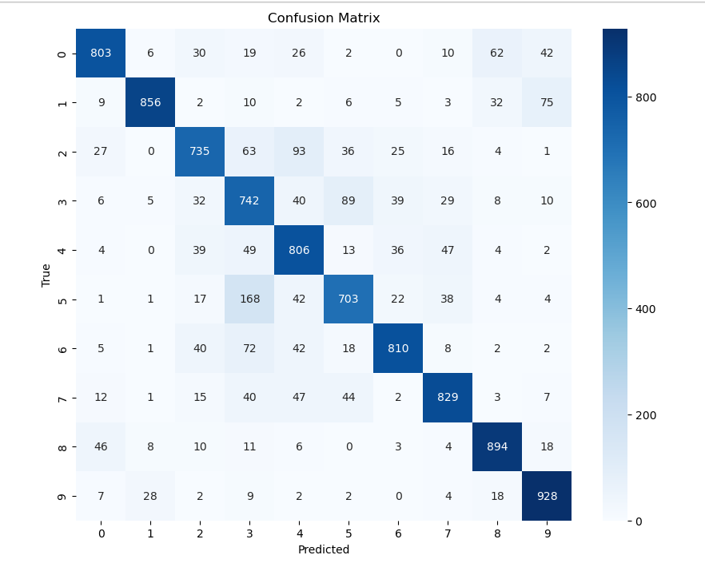
Confusion matrix
This confusion matrix shows how many times the model correctly (diagonal) or incorrectly (off-diagonal) predicted each class. The strongest diagonals are observed in clearly distinguishable classes like airplane, ship, and automobile. Confusion is more common between classes with similar shapes like cat vs. dog or deer vs. horse, which is expected given CIFAR-10 image quality.

Slide 14
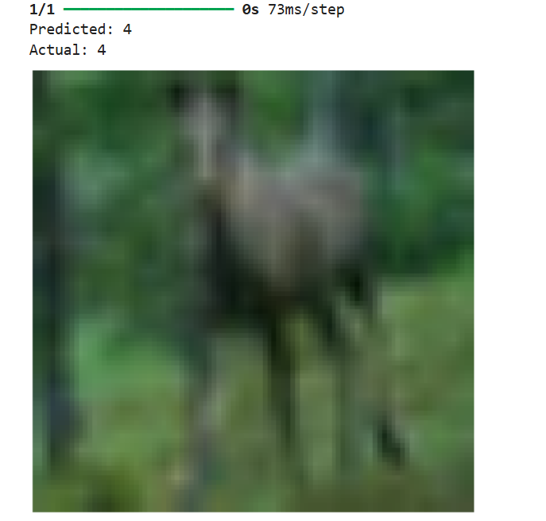
Single Image test
Here, a randomly selected image from the test set is displayed, and the model predicts the class. The predicted label and confidence score are shown alongside the actual class. This demonstrates how the trained model behaves on unseen real-world data.

Slide 15
Strengths & Weaknesses
Strengths:
Transfer Learning reduces training time
High accuracy with small data (Howard et al., 2017).
Works well on small devices (MobileNet)
Weaknesses:
Limited flexibility in MobileNetV2
Requires resizing and pre-processing
Custom CNN prone to overfitting

Slide 16
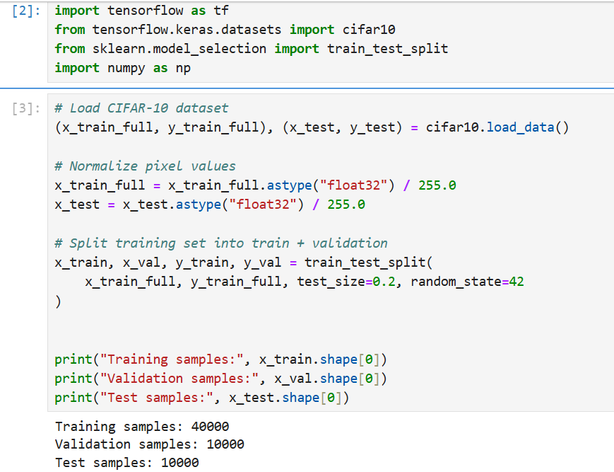
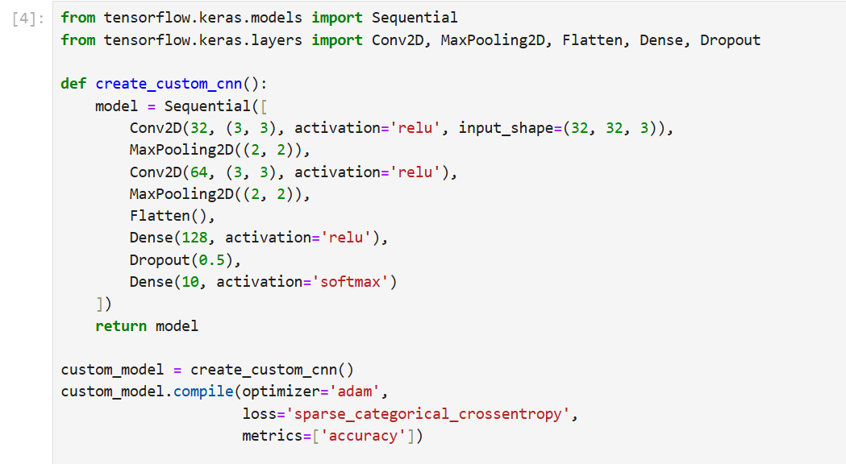
Code

Slide 17
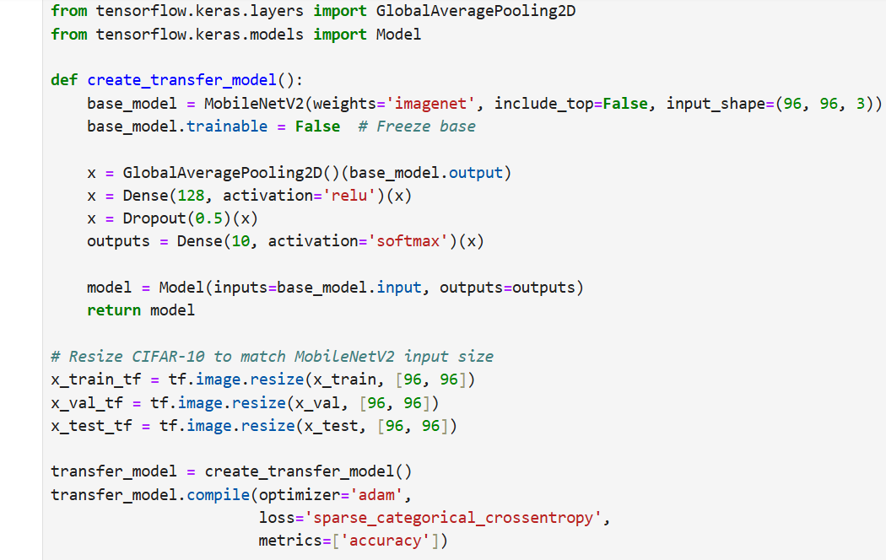
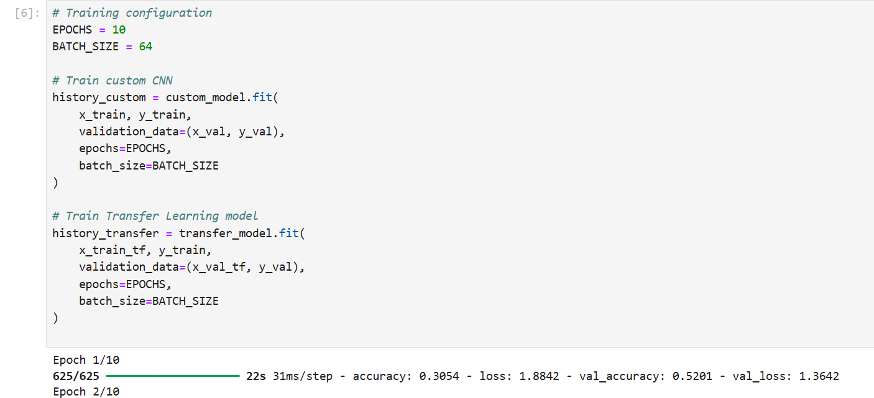

Slide 18
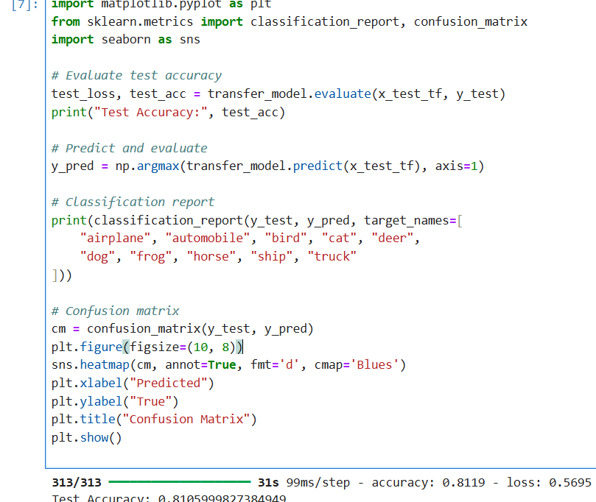
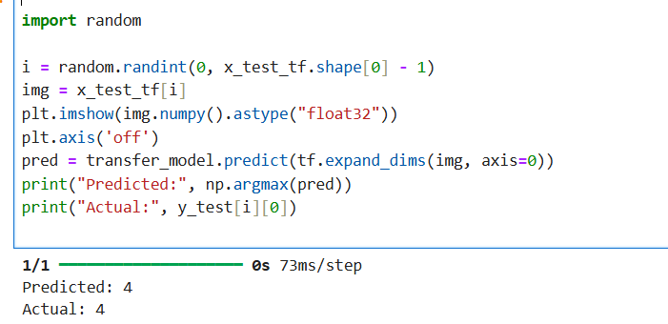

Slide 19
Conclusion
Transfer learning outperformed the custom CNN.
MobileNetV2 achieved higher test accuracy and faster convergence (Howard et al., 2017; Chollet, 2017).
Validation set proved essential to avoid overfitting.
Deep Learning + Pretraining = strong results on real-world image classification.
Notes:
It was evident that the MobileNetV2 transfer learning model scored above the custom CNN in terms of accuracy and convergence. Validation sets, dropout, and early stopping were crucial in their model-building process with regard to generating generalizable models.
This project limits the overall conclusion to the fact that transfer learning is an outstanding approach in the case of small datasets and CIFAR-10 study is one of the great benchmarks to estimate classification models.

Slide 20
References
Brownlee, J. (2022). How to Develop a CNN From Scratch for CIFAR-10 Photo Classification. Machine Learning Mastery. https://machinelearningmastery.com/how-to-develop-a-cnn-from-scratch-for-cifar-10-photo-classification/ (Accessed: 11 July 2025)
Chollet, F. (2017). Deep Learning with Python. Manning Publications. Available at: https://sourestdeeds.github.io/pdf/Deep%20Learning%20with%20Python.pdf (Accessed: 11 July 2025)
Deng, J., Dong, W., Socher, R., Li, L.-J., Li, K., & Fei-Fei, L. (2009). ImageNet: A Large-Scale Hierarchical Image Database. IEEE Conference on Computer Vision and Pattern Recognition (CVPR). Available at: https://ieeexplore.ieee.org/document/5206848 (Accessed: 12 July 2025)
Howard, A. G., et al. (2017). MobileNets: Efficient Convolutional Neural Networks for Mobile Vision Applications. arXiv preprint arXiv:1704.04861. https://arxiv.org/abs/1704.04861 (Accessed: 12 July 2025)
Keras CIFAR-10 example. Available at: https://keras.io/api/datasets/cifar10/ (Accessed: 13 July 2025)
Krizhevsky, A. (2009). Learning Multiple Layers of Features from Tiny Images. University of Toronto. Available at: https://www.cs.toronto.edu/~kriz/learning-features-2009-TR.pdf (Accessed: 13 July 2025)
TensorFlow/Keras Documentation. Transfer learning and fine-tuning guide. https://www.tensorflow.org/tutorials/images/transfer_learning (Accessed: 13 July 2025)

Slide 21


